Slide 1
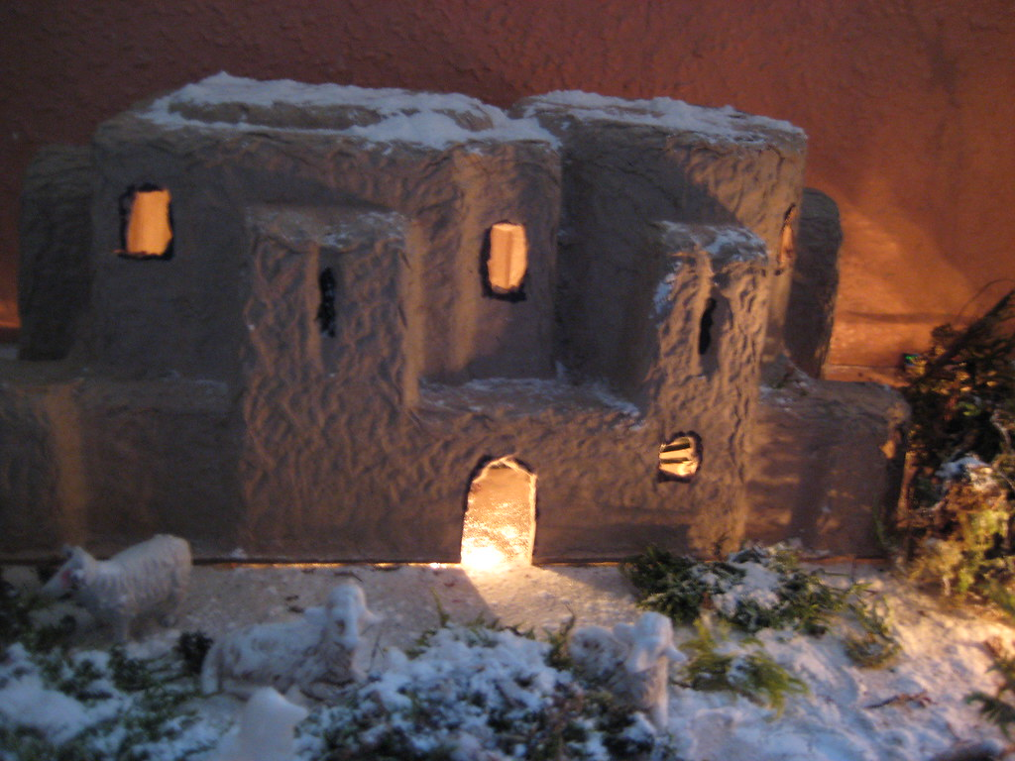
Christmas Surprises
Luke 1:26-38

Slide 2
Christmas Surprises
Luke 1:26-38
A Surprise for Mary
God sent the angel Gabriel to Nazareth, a village in Galilee, to a virgin named Mary. She was engaged to be married to a man named Joseph, a descendant of King David. Gabriel appeared to her and said, ‘Greetings, favoured woman! The Lord is with you’ (NLT).

Slide 3
Christmas Surprises
Luke 1:26-38
1. God surprises us in different ways

Slide 4
Christmas Surprises
Luke 1:26-38
God surprises us in different ways
Mary = confused and disturbed

Slide 5
Christmas Surprises
Luke 1:26-38
God surprises us in different ways
Mary = confused and disturbed
Example: Albert Schweitzer (1952 Nobel Peace Prize)

Slide 6
Christmas Surprises
Luke 1:26-38
God surprises us in different ways
God’s surprises difficult to understand

Slide 7
Christmas Surprises
Luke 1:26-38
God surprises us in different ways
God’s surprises difficult to understand
vv.30-35
“Don’t be afraid, Mary, you have found favour with God. You will conceive and give birth to a son, and you are to call him Jesus. He will be great and will be called the Son of the Most High. The Lord God will give him the throne of his father David, and he will reign over Jacob’s descendants for ever; his kingdom will never end.” ”How will this be,” Mary asked the angel, “since I am a virgin?” The angel answered, “The Holy Spirit will come on you, and the power of the Most High will overshadow you. So, the holy one to be born will be called the Son of God.”

Slide 8
Christmas Surprises
Luke 1:26-38
God surprises us in different ways
God’s surprises difficult to understand
vv.30-35
Disgrace and shame

Slide 9
Christmas Surprises
Luke 1:26-38
God surprises us in different ways
God’s surprises difficult to understand
vv.30-35
Disgrace and shame
Difficult demands

Slide 10
Christmas Surprises
Luke 1:26-38
God surprises us in different ways
God’s surprises difficult to understand
When in doubt, trust God

Slide 11
Christmas Surprises
Luke 1:26-38
God surprises us in different ways
God’s surprises difficult to understand
When in doubt, trust God
Mary’s response
‘I am the Lord’s servant,’ Mary answered. ‘May your word to me be fulfilled.’ Then the angel left her (v.38).

Slide 12
Christmas Surprises
Luke 1:26-38
God surprises us in different ways
God’s surprises difficult to understand
When in doubt, trust God
Mary’s response
Daniel’s response

Slide 13
Christmas Surprises
Luke 1:26-38
God surprises us in different ways
God’s surprises difficult to understand
When in doubt, trust God
Mary’s response
Daniel’s response
Jeremiah’s hope
“Because of the Lord’s great love, we are not consumed, for his compassions never fail...The Lord is good to those whose hope is in him” (Lam.3:22,25).

Slide 14
Christmas Surprises
Luke 1:26-38
God surprises us in different ways
God’s surprises difficult to understand
When in doubt, trust God
Mary’s response
Daniel’s response
Jeremiah’s hope
Quality of faith?

Slide 15
Christmas Surprises
Luke 1:26-38
God surprises us in different ways
God’s surprises difficult to understand
When in doubt, trust God
Mary’s response
Daniel’s response
Jeremiah’s cry
Quality of faith?
Our modern response

Slide 16
Christmas Surprises
Luke 1:26-38
God surprises us in different ways
God’s surprises difficult to understand
When in doubt, trust God
Mary’s response
Daniel’s response
Jeremiah’s cry
Quality of faith?
Our modern response
Don’t ignore God’s gift!

Slide 17
Christmas Surprises
Luke 1:26-38
God surprises us in different ways
God’s surprises difficult to understand
When in doubt, trust God
Mary’s response
Daniel’s response
Jeremiah’s cry
Quality of faith?
Our modern response
Don’t ignore God’s gift!
Many do ignore it

Slide 18
Christmas Surprises
Luke 1:26-38
God surprises us in different ways
God’s surprises difficult to understand
When in doubt, trust God
Mary’s response
Daniel’s response
Jeremiah’s cry
Quality of faith?
Our modern response
Don’t ignore God’s gift!
Many do ignore it
We too are highly favoured!

Slide 19
Christmas Surprises
Luke 1:26-38
God surprises us in different ways
God’s surprises difficult to understand
When in doubt, trust God
Mary’s response
Daniel’s response
Jeremiah’s cry
Quality of faith?
Our modern response
Don’t ignore God’s gift!
Many do ignore it
We too are highly favoured!

